Slide 1
The coming era of Heterogeneous System Architecture(HSA)
BOFIN BABU – 2013H313085H

Slide 2
What are Heterogeneous Systems?
Current CPUs and GPUs are designed as separate processing elements and do not work together efficiently.
Each has a separate memory space, requiring an application to explicitly copy data from CPU to GPU and then back again.
Heterogeneous Systems are improved system designs that enable CPU and GPU work together seamlessly.

Slide 3
A comparison of CPU and GPU cores
 | CPU | GPU
Core | OOO Superscalar | IO SIMD
Branch Predictor | Available | N/A
TLP | 1 to 4 way Simultaneous Multithreading | abundant
Memory | Latency-limited | Bandwidth-limited
Latency Tolerance | Caching | Caching, Multithreading

Slide 4
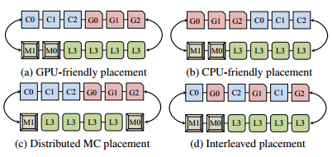
HSA: Some things to consider..
1. H/W arrangement
2. Arbitration Policy
Dispute b/w CPU and GPU
Give higher priorities to CPU applications as they are more latency sensitive
Make sure that when CPU and GPU applications are both bandwidth sensitive, CPU gets it’s fair share
Possible placements for a ring network

Slide 5
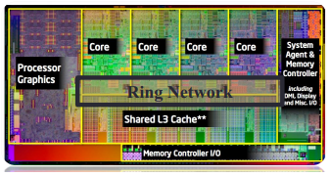
..HSA: Some things to consider
3. Routing Algorithm
Needs better routing algorithms since normal algorithms may result in link congestion in the HSA.
4. Resource Contention and Partitioning
CPU and GPU packets compete for resources.
Usually higher demanding cores (GPUs) acquire the most resources.
Need portioning mechanisms
Shortest distance algorithm: GPU packets prefer lower link while CPU packets prefer upper link. Fig: Intel’s Sandy Bridge

Slide 6
A case study
Performance of Haar Face Detect (a commonly used multi-stage video analysis algorithm)
HW Configuration
4GB RAM; Windows 7 (64-bit); OpenCL 1.1
APU: AMD A10 4600M with Radeon™ HD Graphics
CPU: 4 cores @ 2.3 MHz (turbo 3.2 GHz)
GPU: AMD Radeon HD 7660G, 6 compute units, 685MHz
RESULTS
2.3X performance gain
2.4X reduced power level
Courtesy : AMD

Slide 7
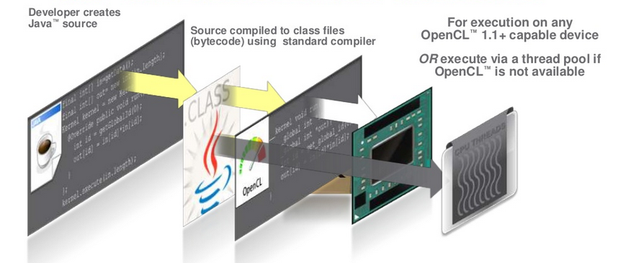
OpenCL and HSA
OpenCL framework for writing programs that execute across heterogeneous platforms
OpenCL can be used to give an application access to a graphics processing unit for non-graphical computing
HAS is an optimized platform architecture for OpenCL
Accelerating JAVA
Convert JAVA Bytecode to OpenCL using Aparapi

Slide 8
Reference
Lee, Li, Kim: Design Space Exploration of On-chip Ring Interconnection for a CPU-GPU Architecture
HSA Foundation (http://www.hsafoundation.com)
AMD’s developers guide to Heterogeneous Computing (http://developer.amd.com/resources/heterogeneous-computing)
Diagrams in this presentation are taken from (1) and (2)

